Slide 1
Cost of Living Analysis
Presenter
- Rutuja Khadkikar

Slide 2
Project Objective
The goal is to analyze the cost of living in different cities and countries.
Understand major expenses people face worldwide.
Highlight economic diversity and challenges influencing daily life.
Major expenses: identify key expenses that contribute significantly to the cost of living: Transport ,housing and education
Explore how these expenses vary across cities and countries.
summarize findings and highlight cities or regions with unique cost of living.

Slide 3
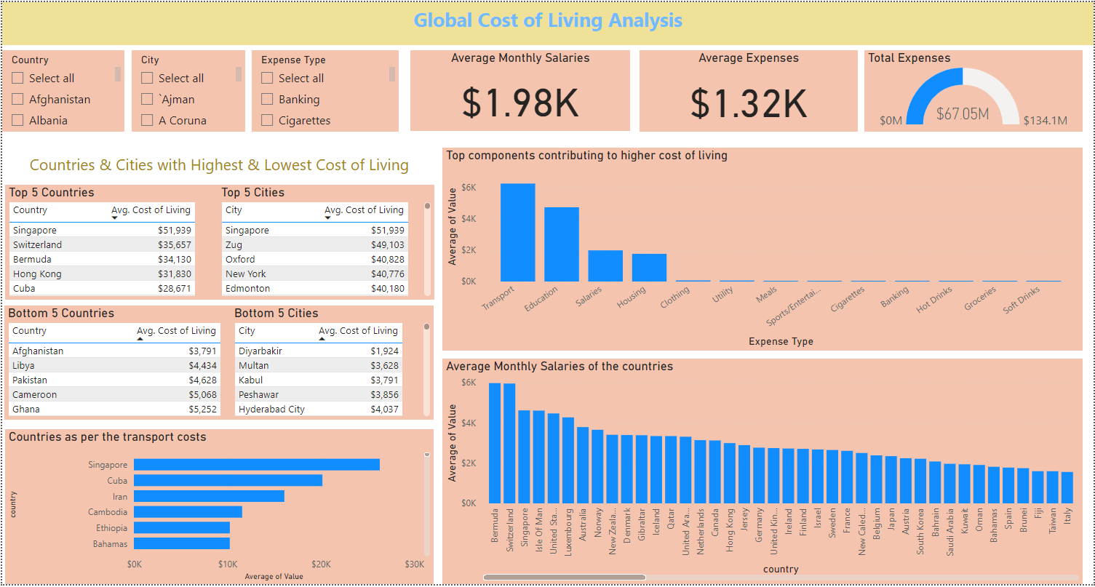

Slide 4
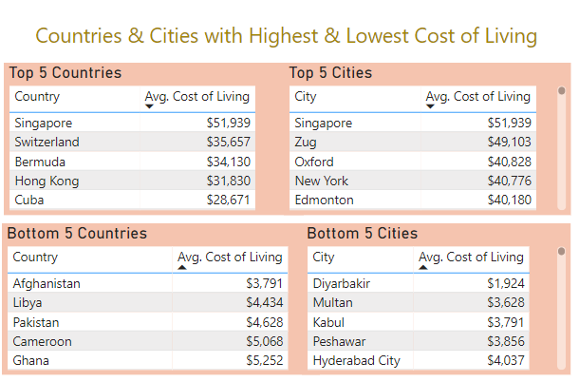
Q. What are the cities and countries with the highest and lowest cost of living?

Slide 5
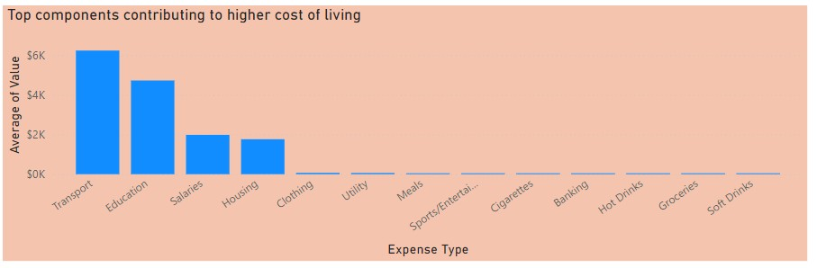
Q. What are the major cost components contributing to overall cost of living?
Transportation :this is the largest cost component across most regions.it includes expenses related to public transport ,private vehicles ,fuel and associated costs.
Education: Education costs include expenses related to private and international schooling.
Income: while not a direct expenses, income influences purchasing power and overall cost of living .higher income regions tend to have higher cost across other categories.
Housing: It includes apartments costs

Slide 6
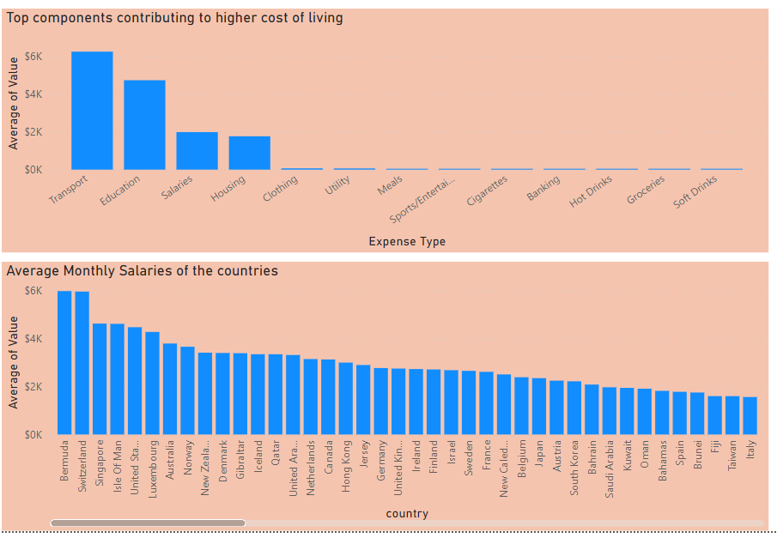
Q. How do factors like average salary,housing costs,and transportation expenses correlate with the cost of living?

Slide 7
Transportation expenses: These have the strongest correlation with overall cost of living. High transportation costs can significantly impact city’s affordability.
Housing costs :Cities with high housing cost tend to have higher overall cost of living .Implementing affordable housing policies and encouraging sustainable housing development can help mitigate this.
Average Salary: While individual salaries correlate with the cost of living ,its essential to consider the combined effect of all factors. A city with high salaries also high housing and transportation costs may still have an elevated cost of living.

Slide 8
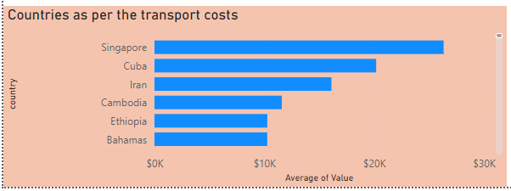
Q. Analysis of average transportation costs across various countries
Singapore: With an average transportation, Singapore leads the pack. The high cost is likely driven by expensive new cars and significant transportation – related expenses .Singapore’s policies on car ownership, including high taxes and fees to limit the number of vehicles on the road, contributes to this figure.
Cuba: Following closely, cuba has the second highest average transportation cost. Limited vehicle availability, high import taxes ,and fuel costs contribute to this expenses.
This findings emphasize the significant impact of transportation costs on the overall cost of living, especially in Singapore & cuba .Strategic economic and policy interventations are necessary.
For Singapore: Investing in public transport infrastructure and reducing car ownership costs is key

